Slide 1
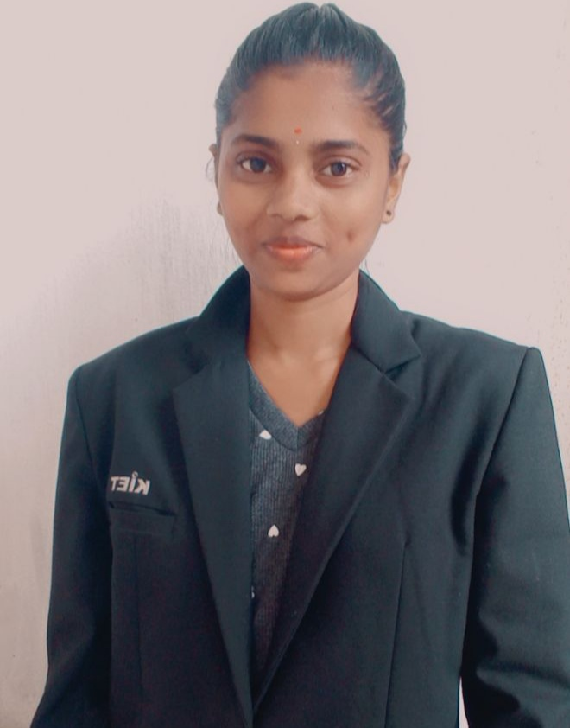
STUDENT DETAILS
NAME OF THE STUDENT:SOMISETTI JAHNAVI
STUDENT ROLL NUMBER:20B21A4516
SKILLS BUILD MAIL-ID:somisettijahnavi16@gmail.com
COLLEGE NAME: KAKINADA INSTITUTE OF ENGINEERING AND TECHNOLOGY
COLLEGE STATE: Andhra Pradesh
INTERNSHIP DOMAIN:ARTIFICIAL INTELLIGENCE
INTERNSHIP START DATE AND END DATE:09/06/2023 --07/07/2023
STUDENT PHOTO

Slide 2
PROJECT TITLE AND PROBLEM STATEMENT
PROJECT TITLE:
EMPLOYEE_BURNOUT_ANALYSIS AND PREDICTION
PROBLEM STATEMENT:
Employee burnout has become a significant issue in many organizations, leading to decreased productivity, increased turnover, and a negative impact on both employee health and organizational performance. Despite its prevalence, there is a lack of comprehensive, data-driven methods to predict and analyze burnout, making it difficult for organizations to proactively address this issue. The aim of this project is to develop a predictive model that can accurately identify employees at risk of burnout based on various factors such as workload, work-life balance, job satisfaction, and personal circumstances. This will enable organizations to implement timely interventions and strategies to prevent burnout, thereby improving employee well-being and organizational effectiveness.

Slide 3
AGENDA
DATA LOADING
DATA VISUALIZATION
DATA PRE-PROCESSING
LINEAR REGRESSION

Slide 4
PROJECT OVERVIEW
PURPOSE
Purpose: Analyze employee burnout to improve well-being and productivity.
Impact: Provide strategies and interventions to mitigate burnout and enhance organizational performance.
SCOPE
Focus: Analyze burnout across industries and organizational sizes.
Factors: Consider workload, job demands, work-life balance, leadership styles, and culture to understand burnout comprehensively.
OBJECTIVE
Identify: Determine prevalence and levels of burnout in different industries and organizations.
Understand: Explore factors contributing to burnout and their impact on well-being and job satisfaction.

Slide 5
Who are the end users of this project?
ORGANIZATION/COMPANIES
Characteristics & Benefits: Various industries, small to large organizations. Improve well-being and retention through effective burnout prevention and management.
HUMAN RESOURCE PROFESSIONALS
Characteristics & Benefits: HR managers, professionals, practitioners. Access tools and resources for measuring and addressing burnout effectively.
MANAGERS/SUPERVISORS
Characteristics & Benefits: Team leaders, supervisors, managers. Implement interventions for positive work environments and work-life balance.
EMPLOYEES/WORKERS
Characteristics & Benefits: All employees across industries. Gain support to manage burnout and improve well-being.

Slide 6
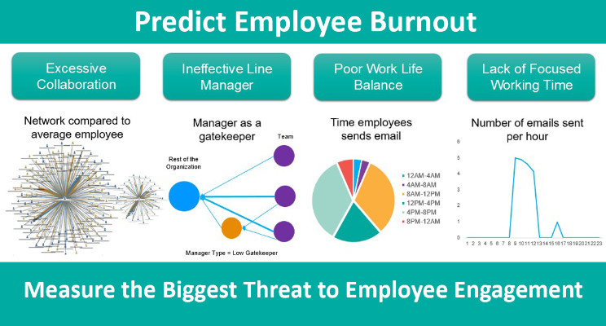
YOUR SOLUTION AND IT’S VALUE PROPOSITION
This project provides comprehensive analysis, actionable insights, and tailored interventions to organizations, HR professionals, and managers. We contribute to research, offer training, and promote a culture of well-being, resulting in improved employee well-being, productivity, and organizational performance.

Slide 7
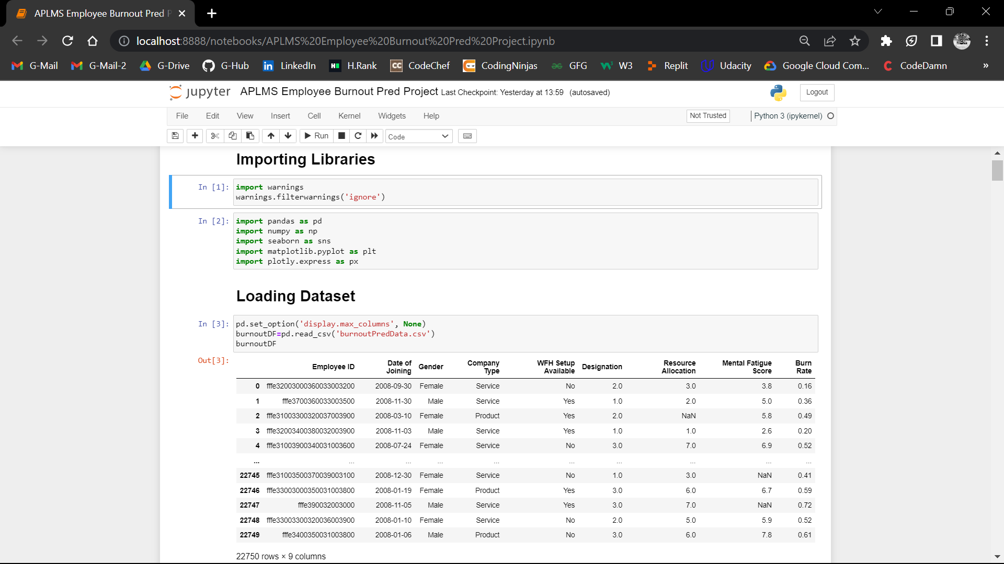
HOW DID YOU CUSTOMIZE THE PROJECT & MAKE IT YOUR OWN
DATA LOADING:
leverage the dataset provided by EDUNET to ensure accurate and reliable analysis of employee burnout.

Slide 8
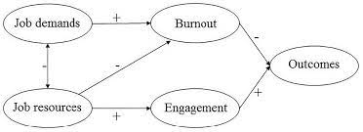
MODELING
1. Maslach Burnout Inventory (MBI)
2. Job Demands-Resources (JD-R) Model
3. Effort-Reward Imbalance (ERI) Model
4. Job Crafting Framework
5. Self-Determination Theory (SDT)

Slide 9

RESULTS
Outcomes of the Project
Comprehensive Understanding
Burnout Prevention Strategies
Research Contribution
Success of the Project
Improved Employee Well-being
Enhanced Organizational Performance
Positive Stakeholder Feedback
Sustainability and Long-Term Impact

Slide 10
LINKS
GITHUB REPOSITARY LINK : https://github.com/somisettijahnavi16
EMAIL-ID: somisettijahnavi16@gmail.com
LINKEDIN: https://www.linkedin.com/in/somisetti-jahnavi-127825248
PROJECT CODE LINK::https://colab.research.google.com/drive/1SA_fwGr1gaAK4fwPOrOlOzEZPYitsYjK
DATA SET LINK::https://drive.google.com/file/d/15-qvTRPzrfudCOH-iD1w73S1oWsifk7F/view?usp=drivesdk
PROJECT PDF::https://drive.google.com/file/d/1AI4RAlU6iBY0ukpOB4DCH3l_tmZ7rHa-/view?usp=drivesdk

Slide 11
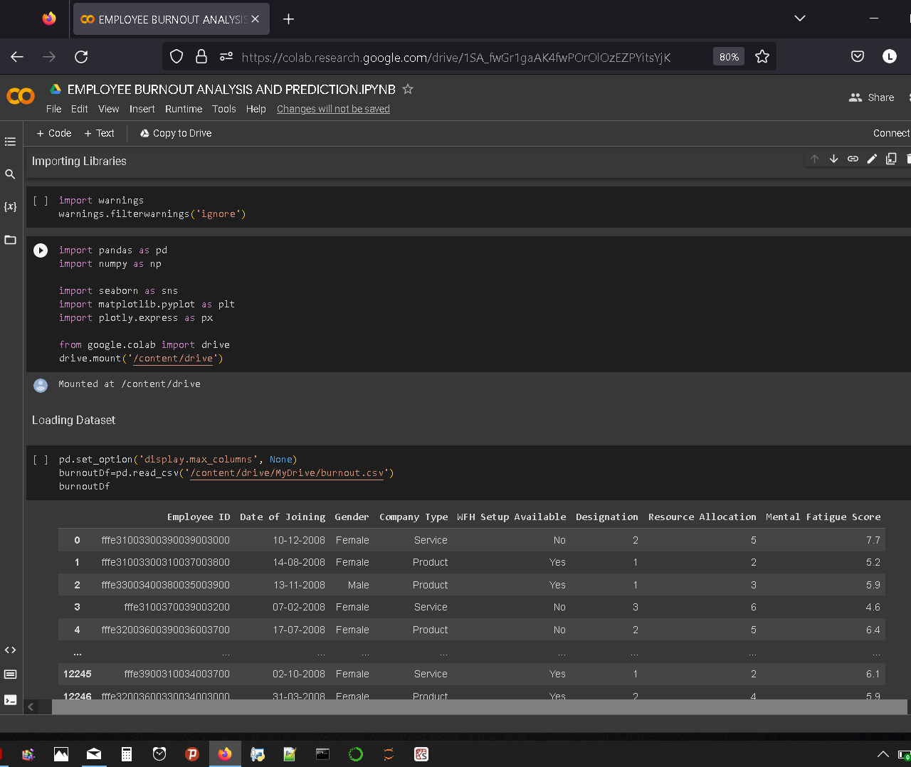
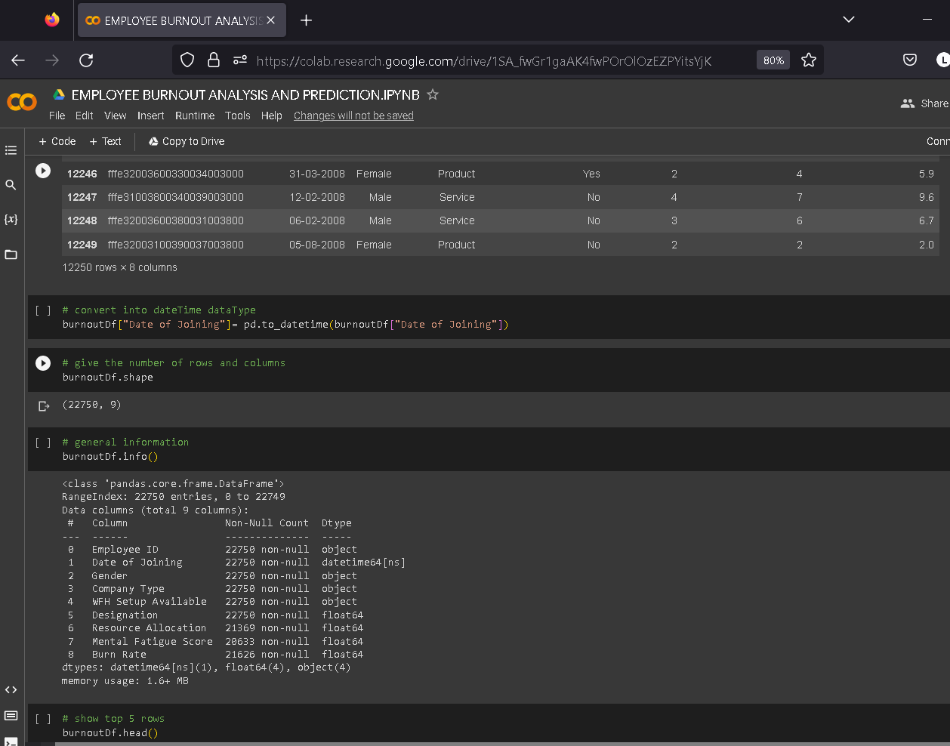
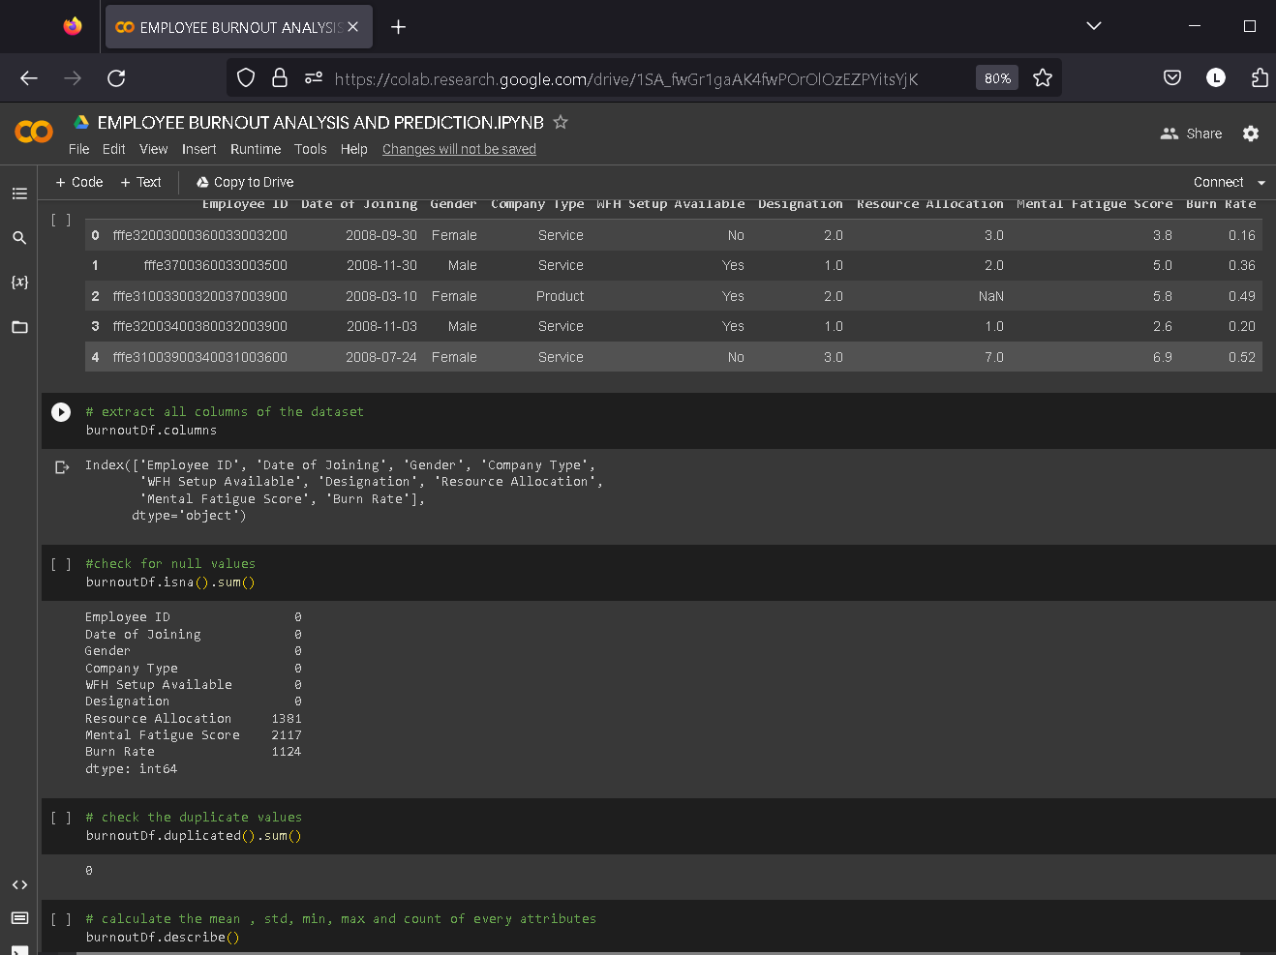
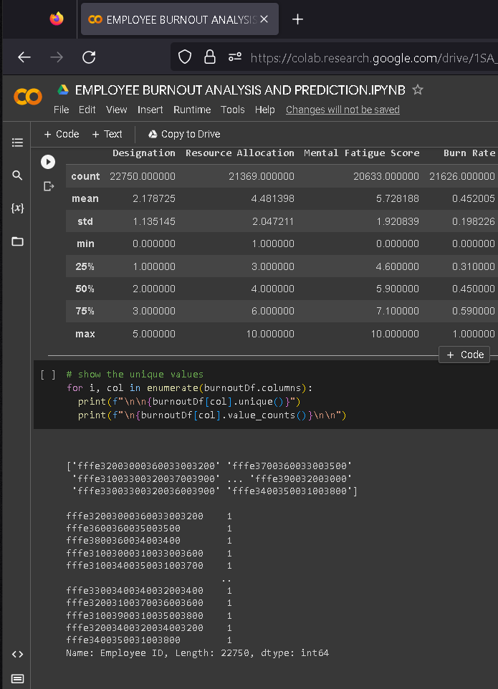
SCREENSHOTS OF PROGRAM

Slide 12
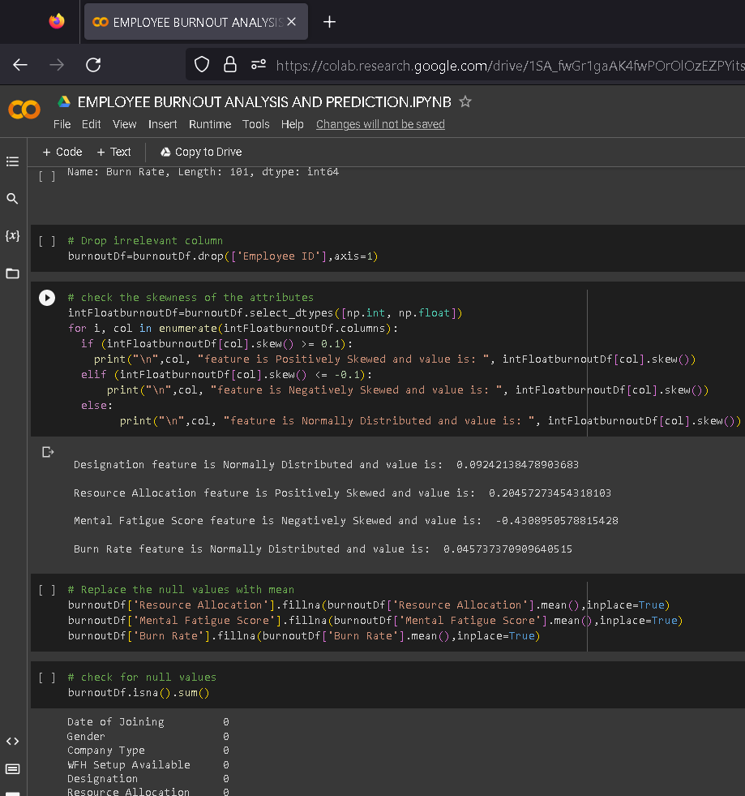
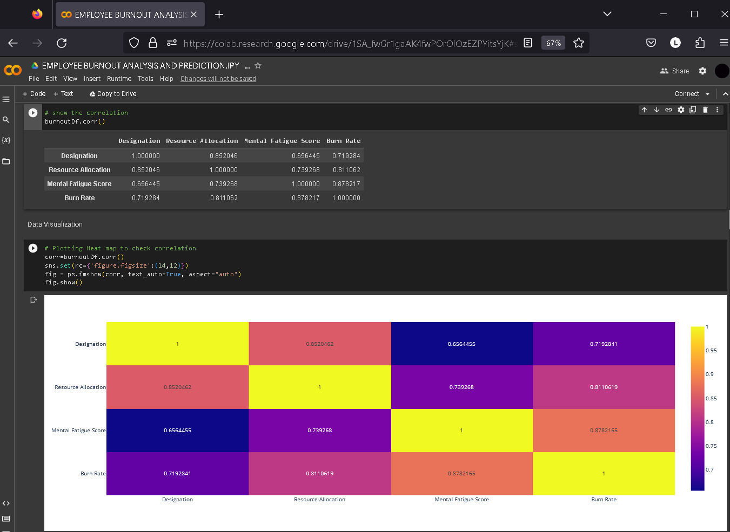
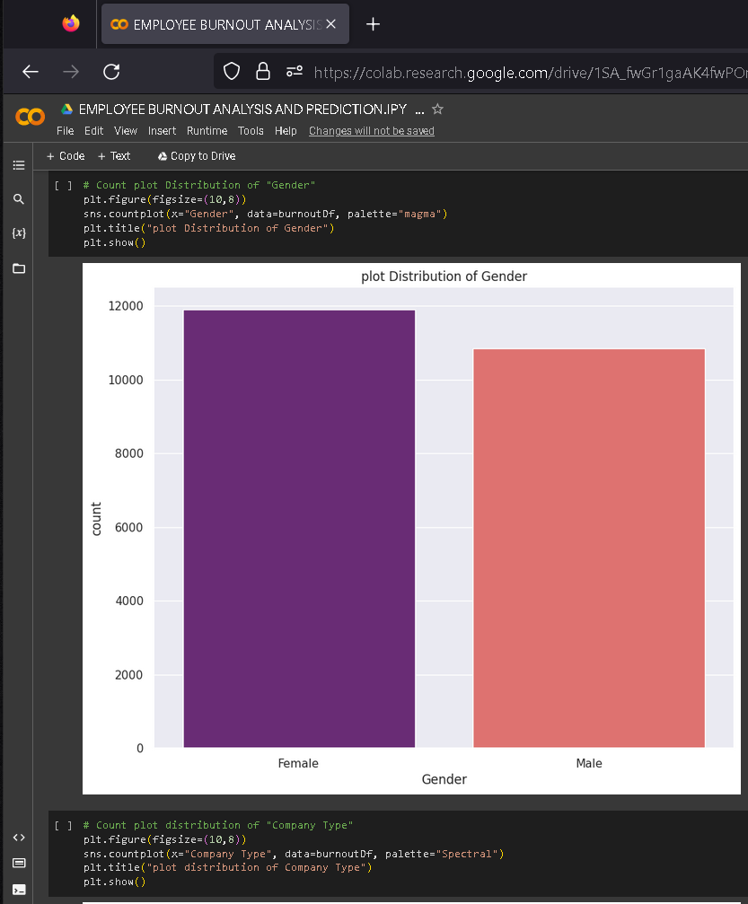
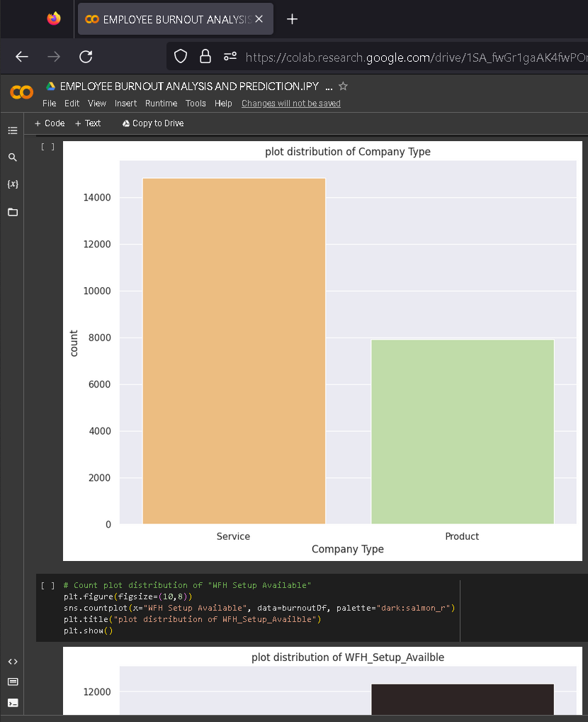

Slide 13
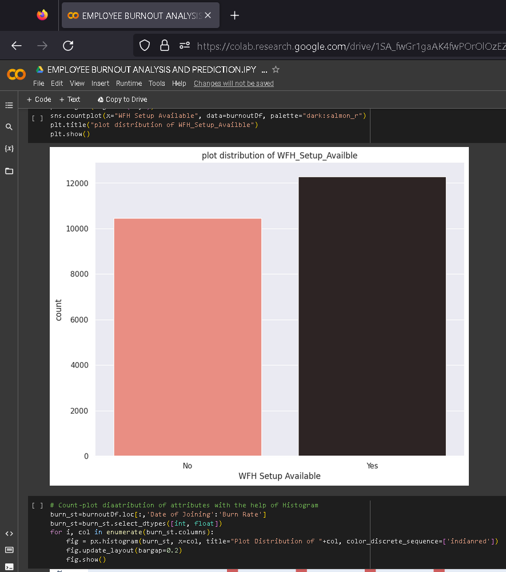
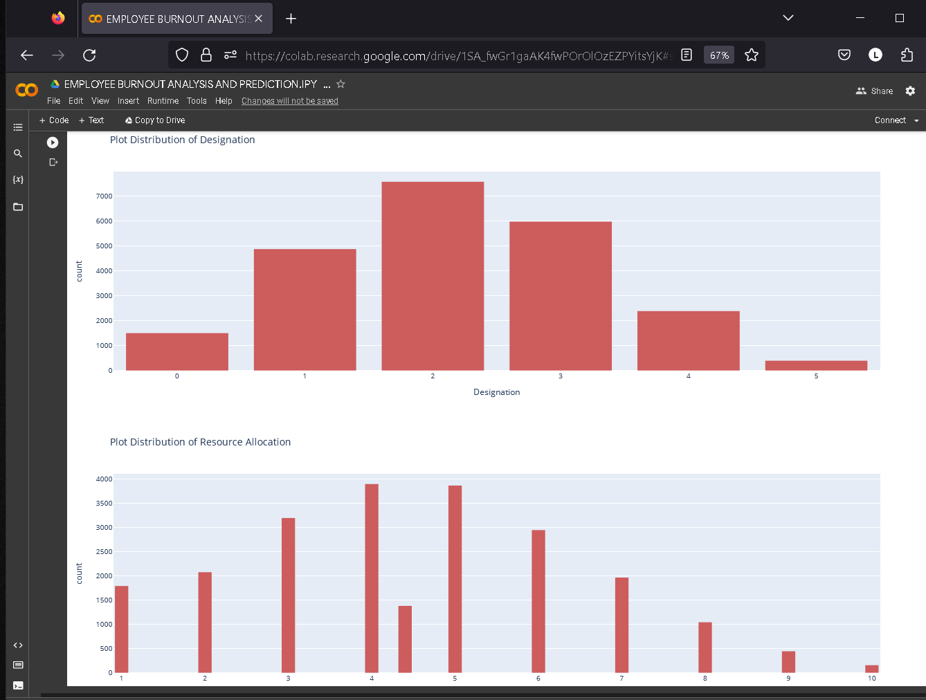
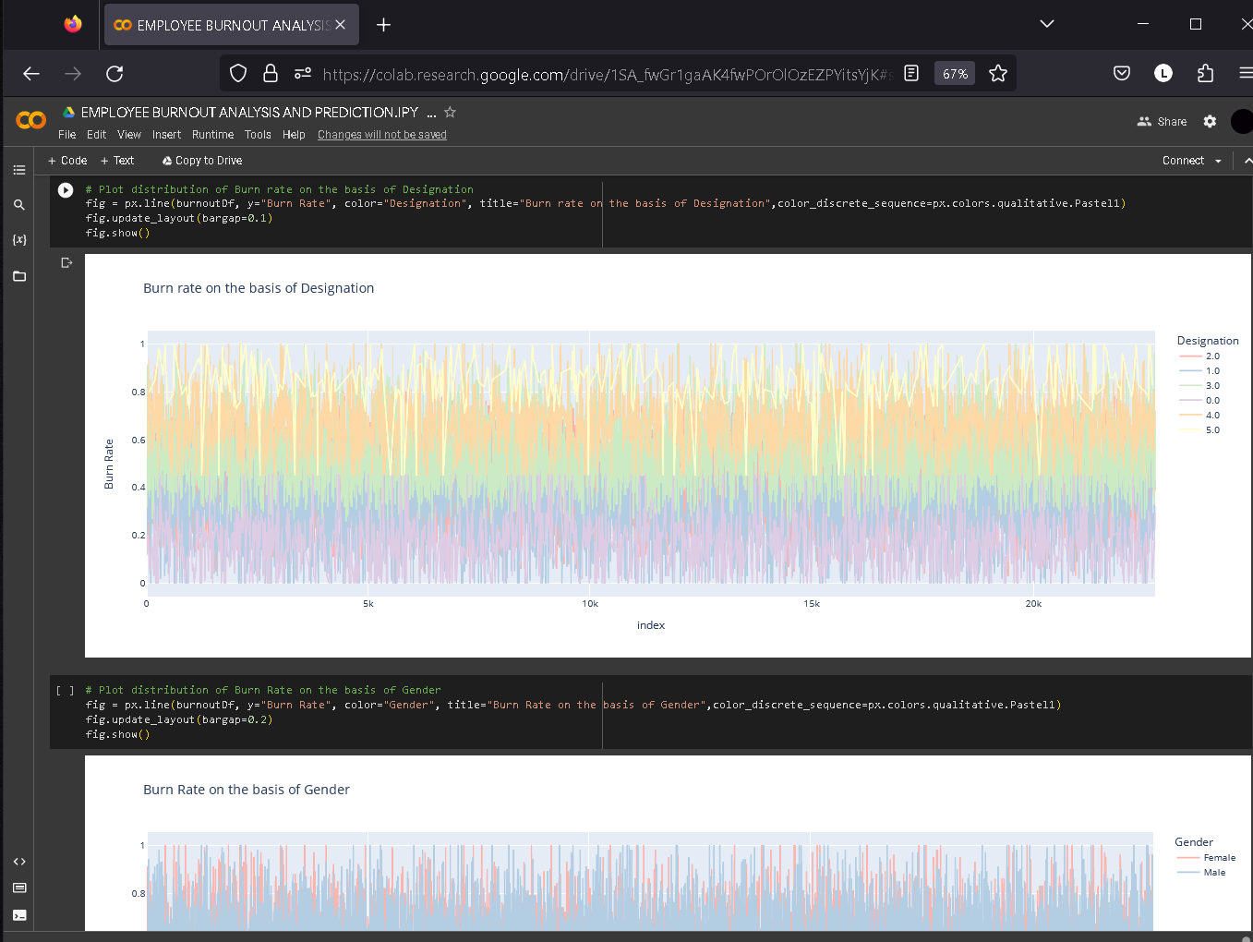
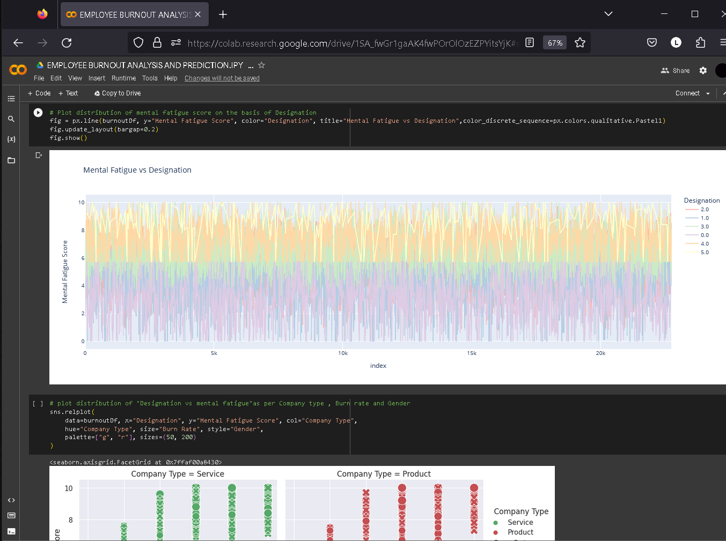

Slide 14
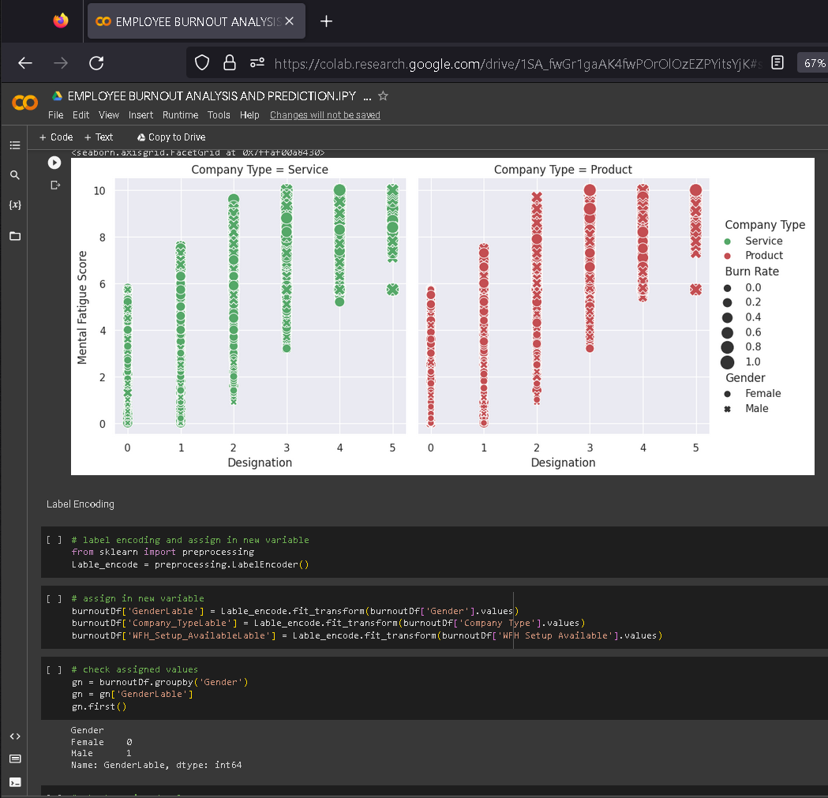
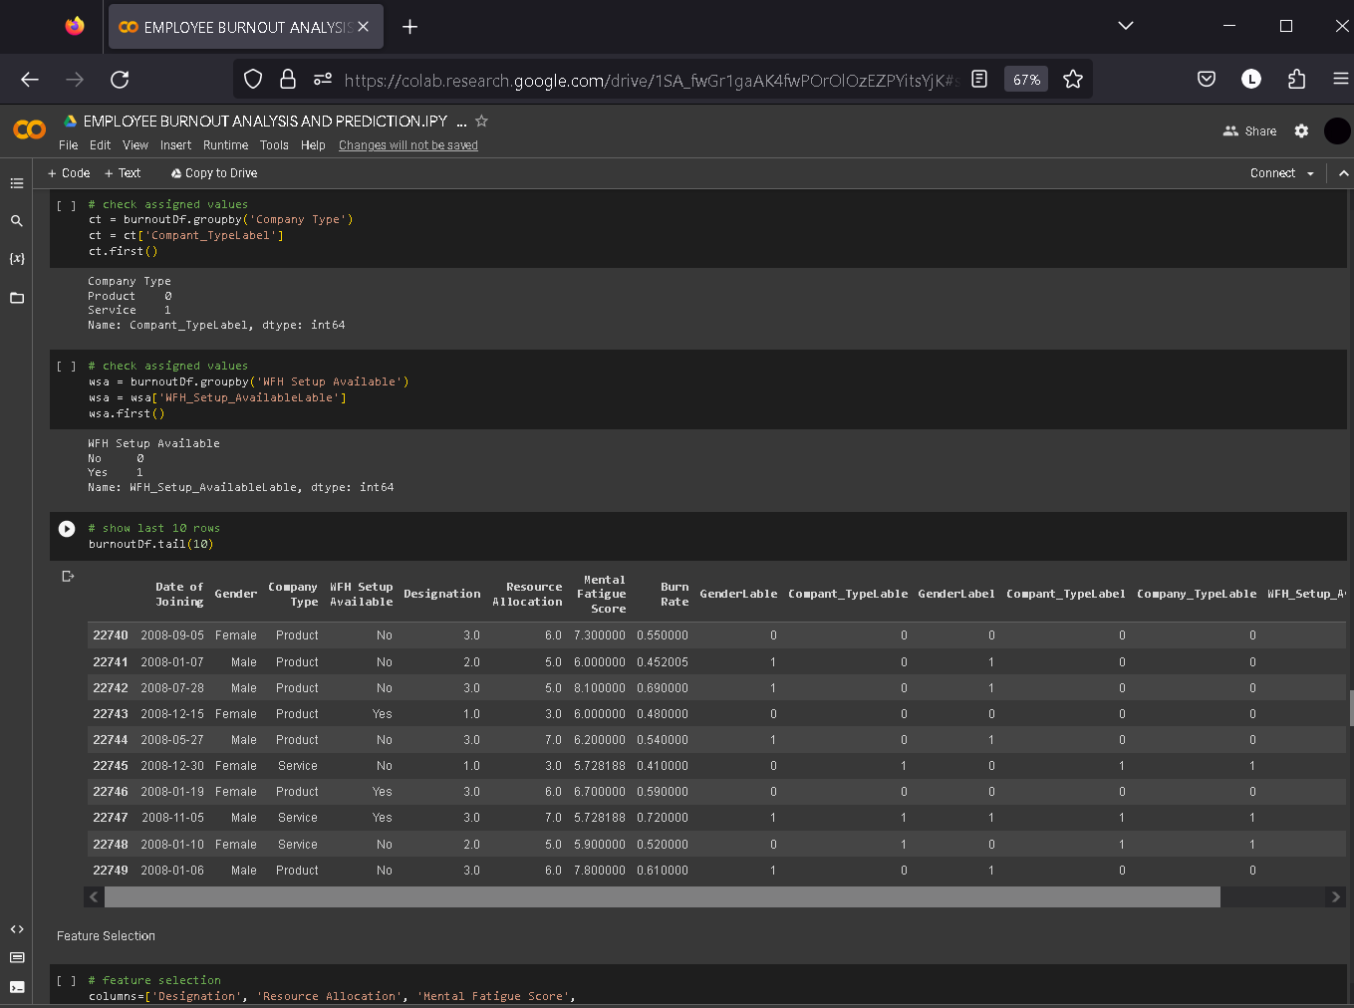
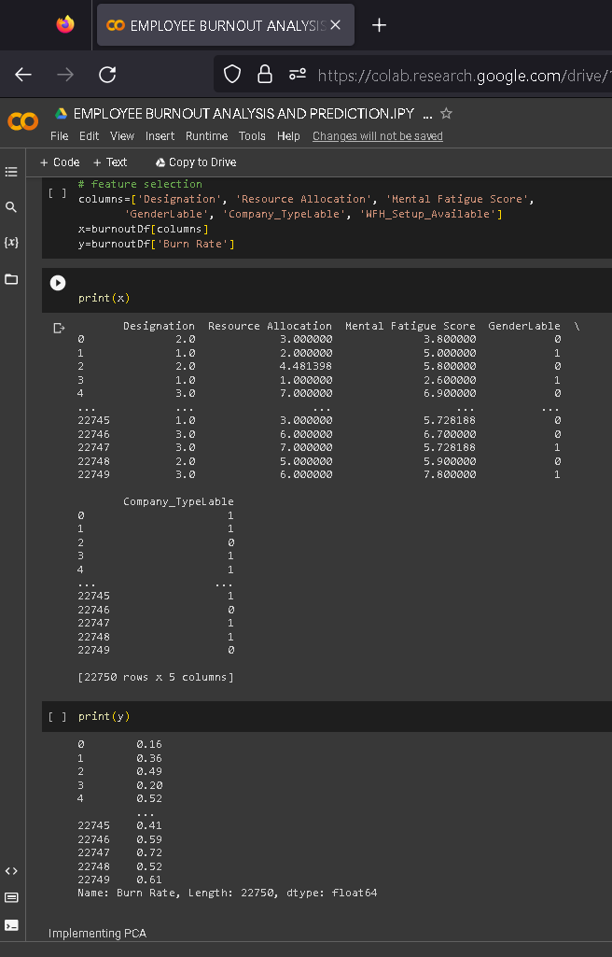
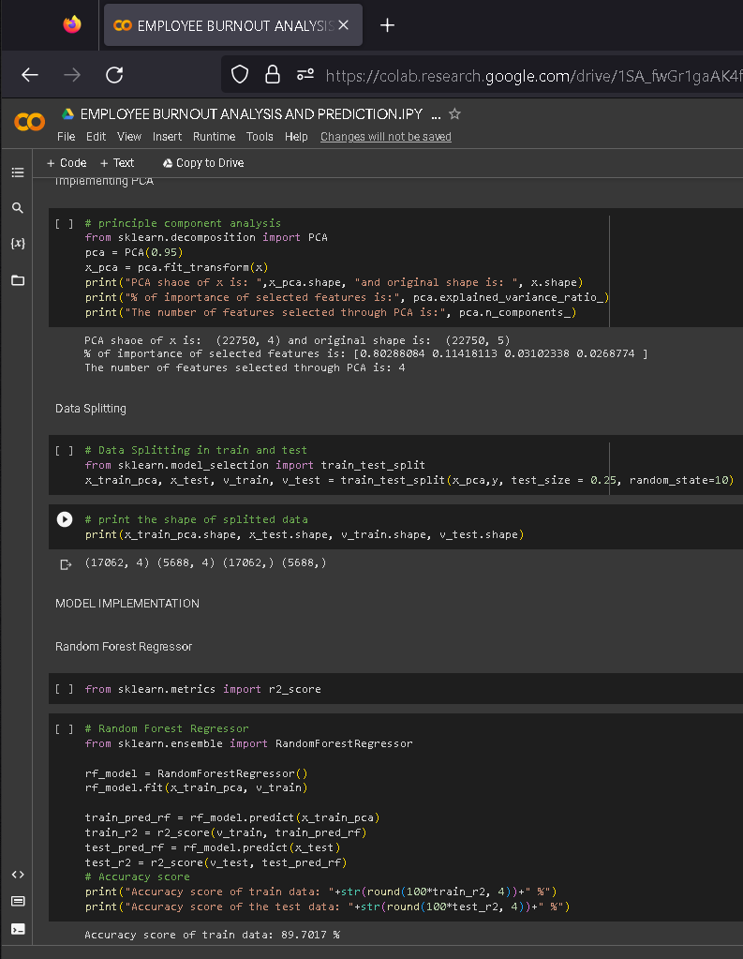
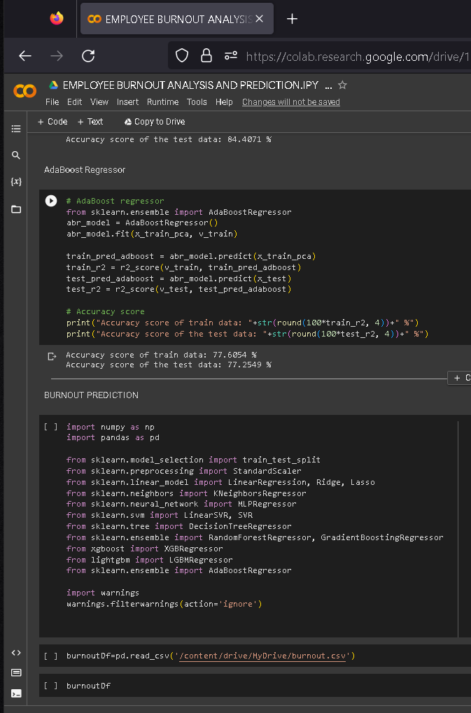

Slide 15
